Slide 1

Operational Dashboards
Leveraging Dashboard tools

Slide 2
Operational Dashboards
SCOM/Azure monitor visualizations
PowerBI
3rd party – Silect and SquaredUp

Slide 3
Operational Dashboards - 2
Visualize tool data
Show degraded and impacting issues is another way to consume
Notify SME’s of problems
Notify Teams with reports of issues (summary)
Unicorn = Single pane of glass
Visualization tools
SCOM SQL visualizations (metro tile for state/alerts) – little to no cost as part of ELA (Enterprise License Agreement)
Azure Monitor (AzMon) - hybrid solution to monitor cloud/premise network/devices
PowerBI - low cost for published reports, uses SSRS for Report gateway
3rd party tools - Silect and SquaredUp, NICE, Splunk, Solarwinds, VMWare, Tanium, Tychion, HBSS/McAfee

Slide 4
SCOM
SQL Visualizations

Slide 5
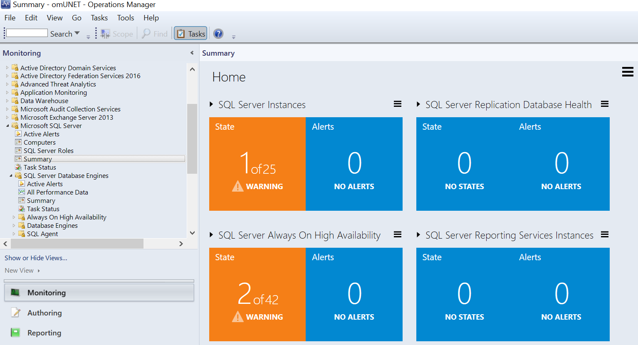
SCOM Visualizations
SCOM SQL
Visualizations
Example - SQL Server Summary View

Slide 6
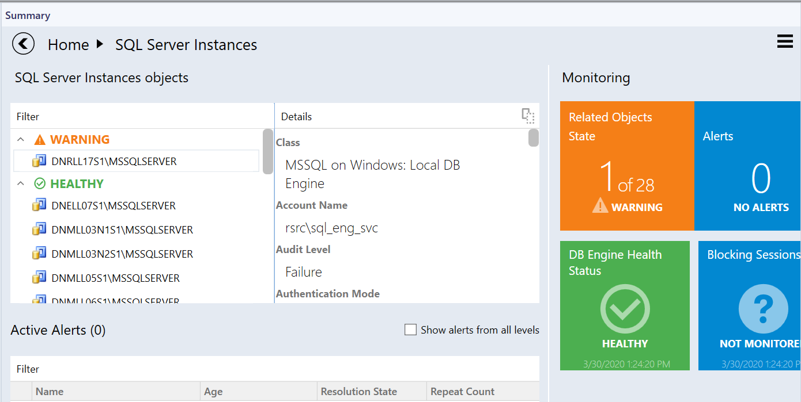
SCOM SQL visualizations
SQL Server Summary View - Drilldown

Slide 7
AzMON
Azure Monitor and Grafana visualizations

Slide 8
AzMon
Hybrid Cloud/Premise connectivity
Leverage Cloud features
Uses SCOM/MMA agent to integrate functionality

Slide 9

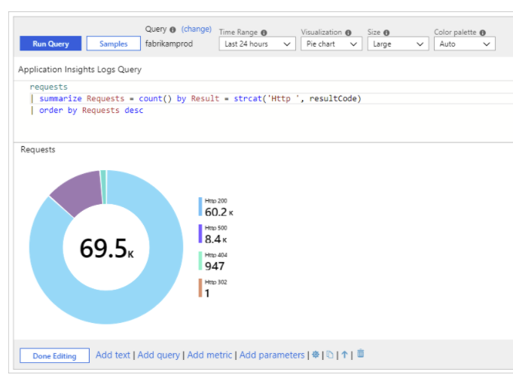
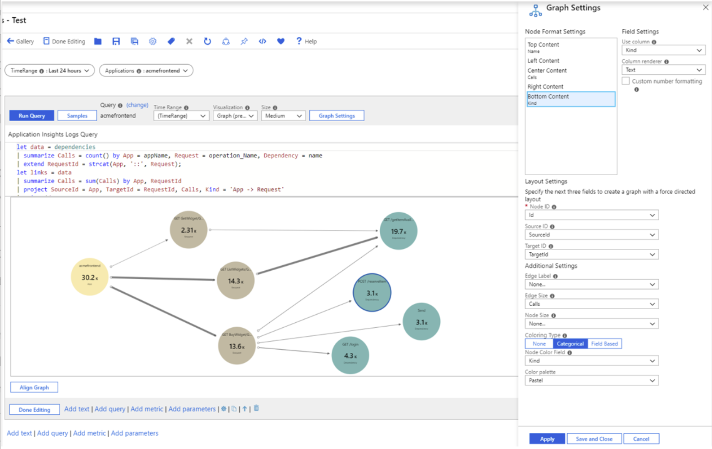
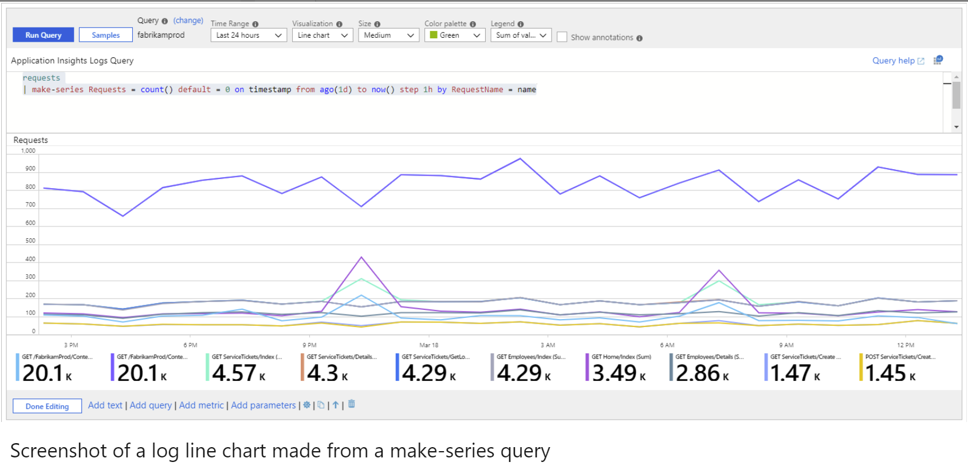
AzMon - 2
Enables additional functionality –
Application Insights for App Perf Mgmt (APM)
Application/Service Map
Azure Workbook visualizations
Custom Dashboards
Grafana visualizations

Slide 10
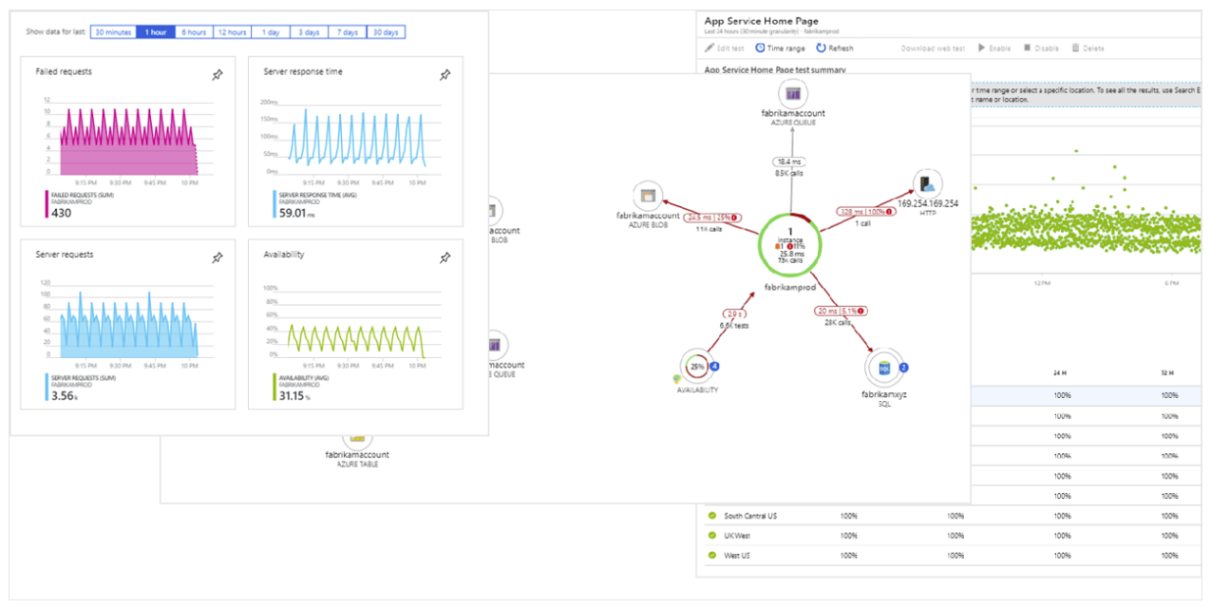
AzMon - 3
Additional visualizations

Slide 11
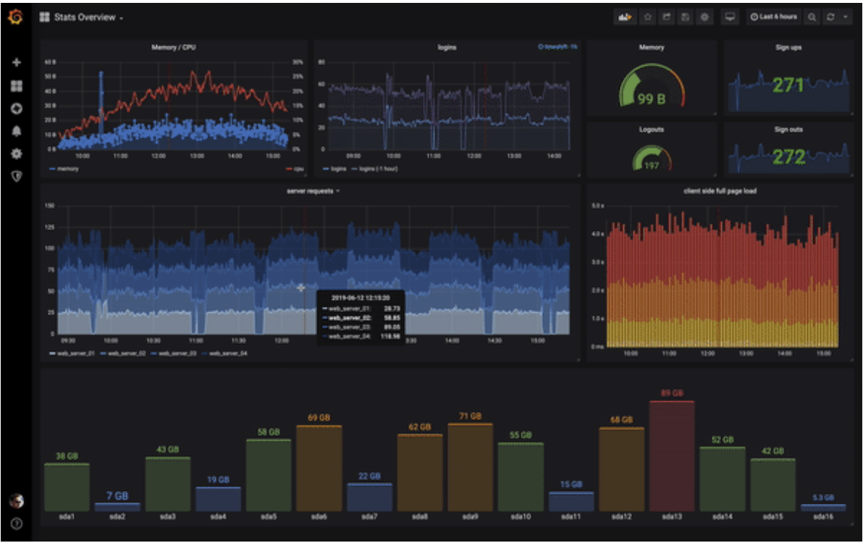
AzMon -3 Azure Monitor (AzMon) visualizations
Leverage Azure Log Analytics (ALA) data for visualizations
Support for all the Azure Monitor metrics
includes support for the latest API version that allows multi-dimensional filtering for the Storage and SQL metrics.
Automatic time grain mode which will group the metrics by the most appropriate time grain value depending on whether you have zoomed in to look at fine-grained metrics or zoomed out to look at an overview.
Application Insights metrics
Write raw log analytics queries, and select x-axis, y-axis, and grouped values manually.
Support for Log Analytics (both for Azure Monitor and Application Insights)
You can combine metrics from both services in the same graph.

Slide 12
PowerBI
Leverage SQL DB, XLS and other data sources for visualizations

Slide 13
PowerBI
System Center enterprise dashboards (SCED)
Teams Application
Custom PowerBI visualizations e.g. heatmap

Slide 14
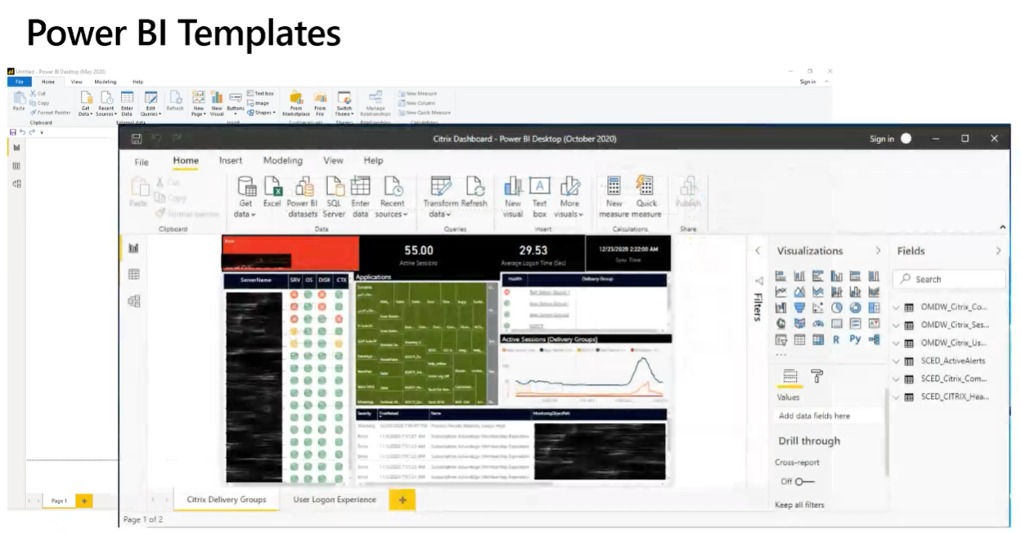
PowerBI
Use System Center Enterprise Dashboards solution to utilize PowerBI templates towards custom visuals
Easy navigation - Drill down into the dashboard to see health state details (click on tab or double click on graph/icon above)

Slide 15
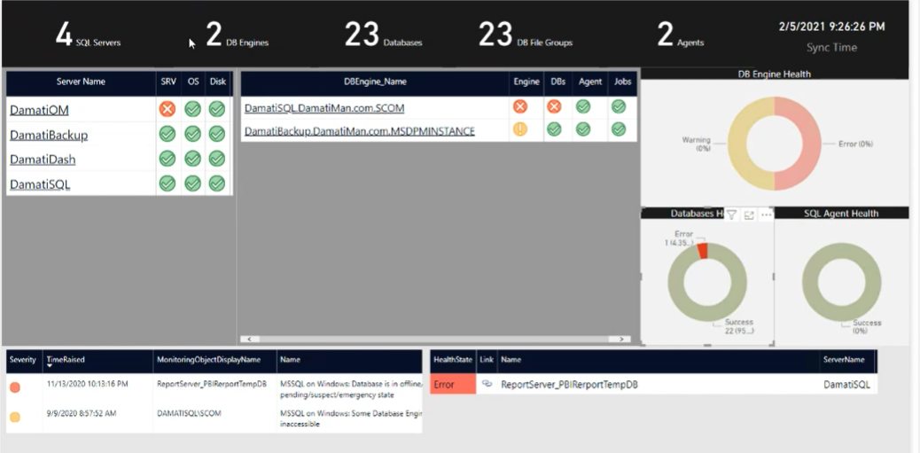
PowerBI - 2
Leverage PowerBI template options to break out application specific health state

Slide 16
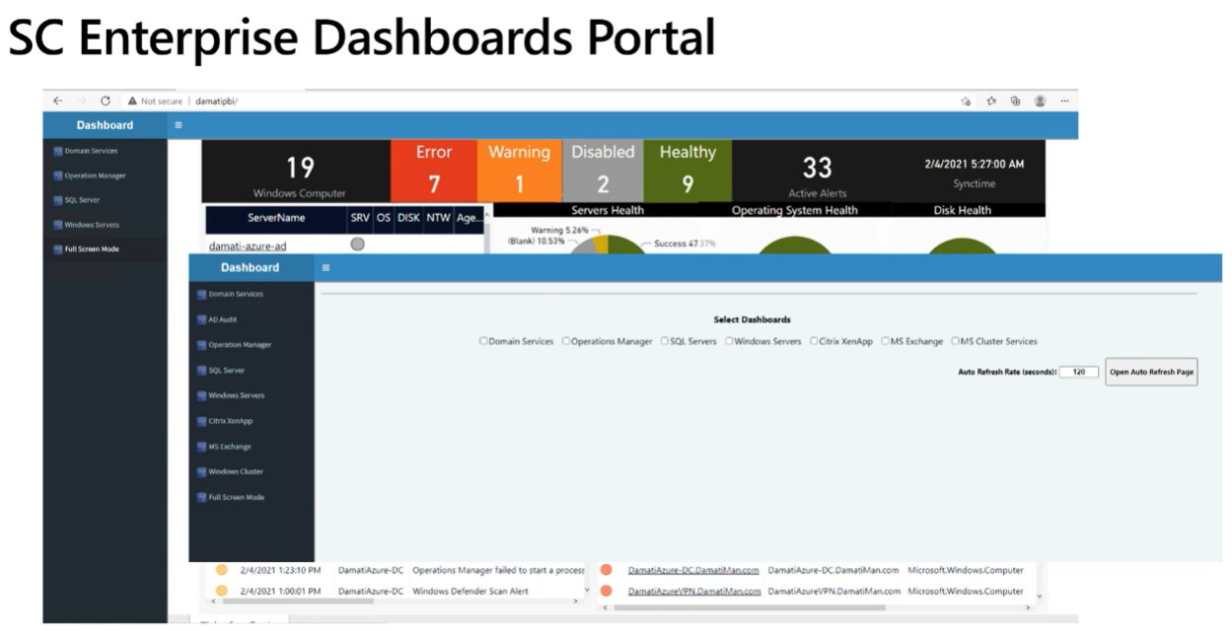
PowerBI - 3
Leverage System Center Enterprise Dashboards solution to leverage SCOM group data into PowerBI report Server based reports

Slide 17
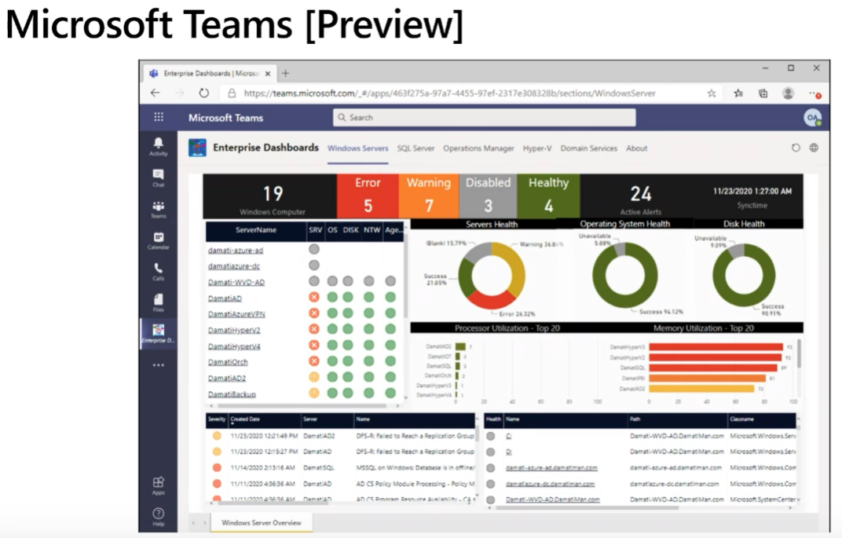
PowerBI - 4
System Center Enterprise Dashboards solution has a Teams App (preview) that can be used to view dashboards

Slide 18
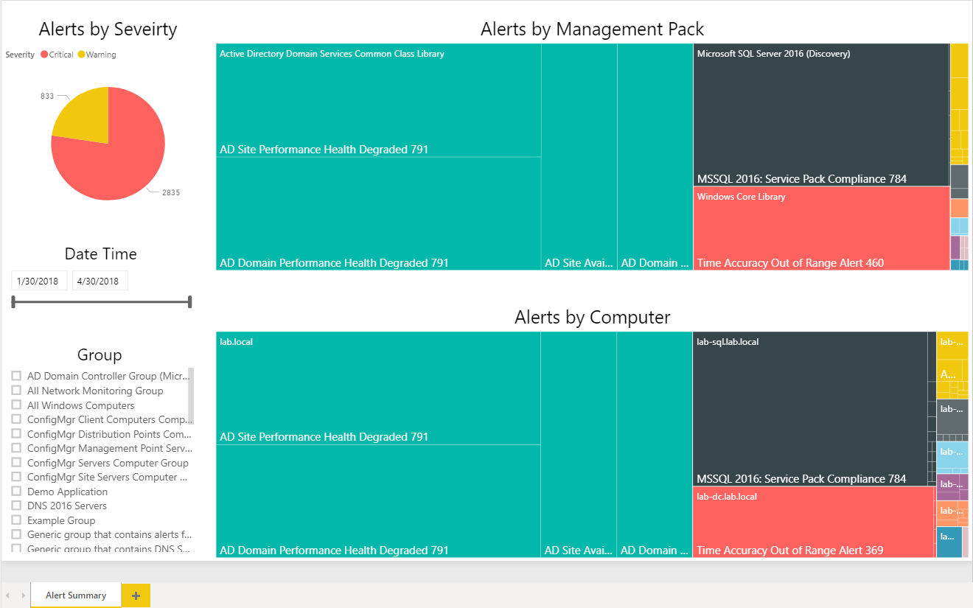
PowerBI - 5
Leverage additional Visualizations like heatmap
PowerBI has capabilities to ingest any DataSource – i.e. System Center tools, Splunk, Solarwinds, Tanium, etc.
Requires knowledge of DB schema to create visualizations
Example view = Health Map
larger panes are larger amounts of alerts

Slide 19
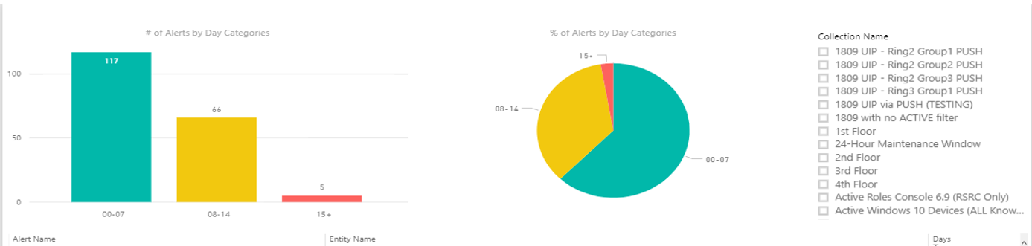
PowerBI - 6
Leverage SQL queries of Tool to visualize
Example pic is MECM data to show collections and alerts by day (age of alerts)

Slide 20
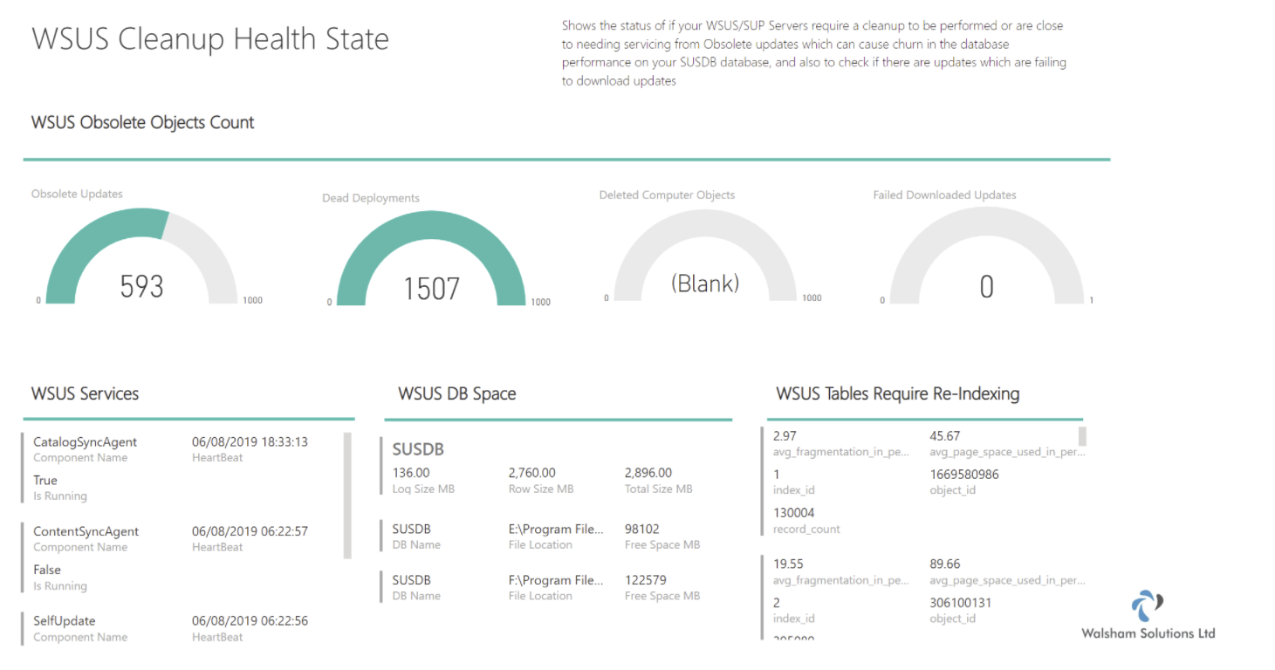
PowerBI - MECM
Leverage published solutions for MECM (formerly SysCtr ConfigMgr)

Slide 21
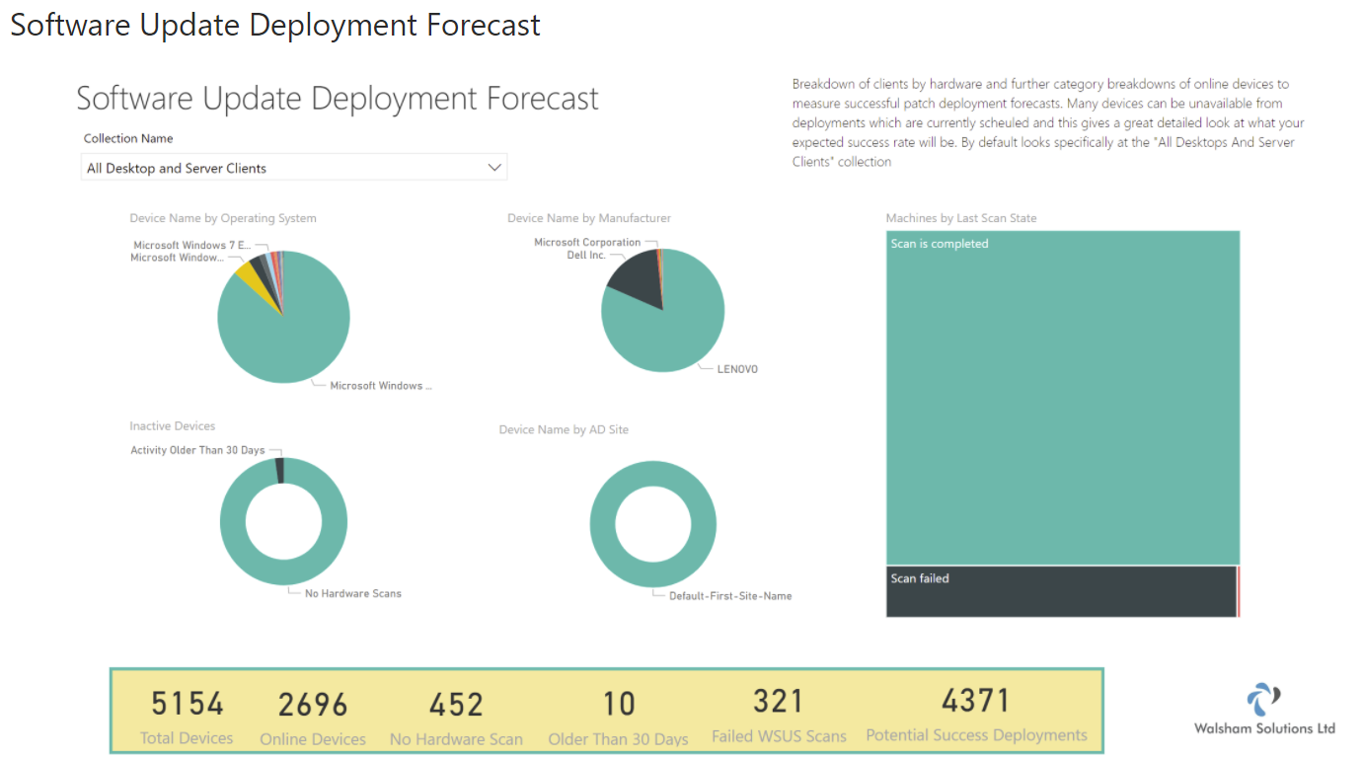
PowerBI – MECM 2
Second example of Software updates

Slide 22
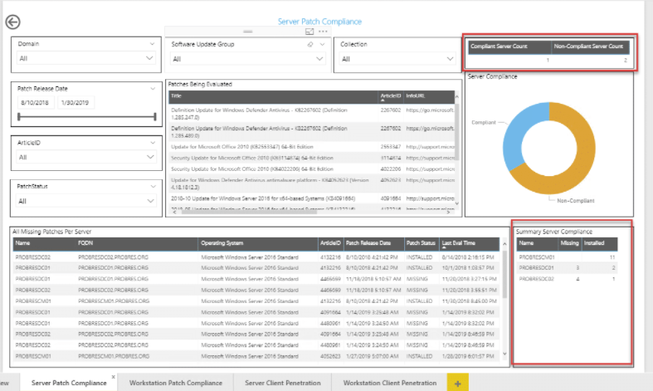
PowerBI – MECM 3
Example of Patch Compliance

Slide 23
3rd party
Visualizations provided by other tools

Slide 24
3rd Party pathway
Pretty much each tool company provides a way to visualize data
Show degraded and impacting issues is another way to consume
Notify SME’s of problems
Notify Teams with reports of issues (summary)
Unicorn = Single pane of glass
3rd party tools – Silect, SquaredUp, NICE, Splunk, Solarwinds, VMWare, Tanium, Tychion, HBSS/McAfee, VEEAM

Slide 25
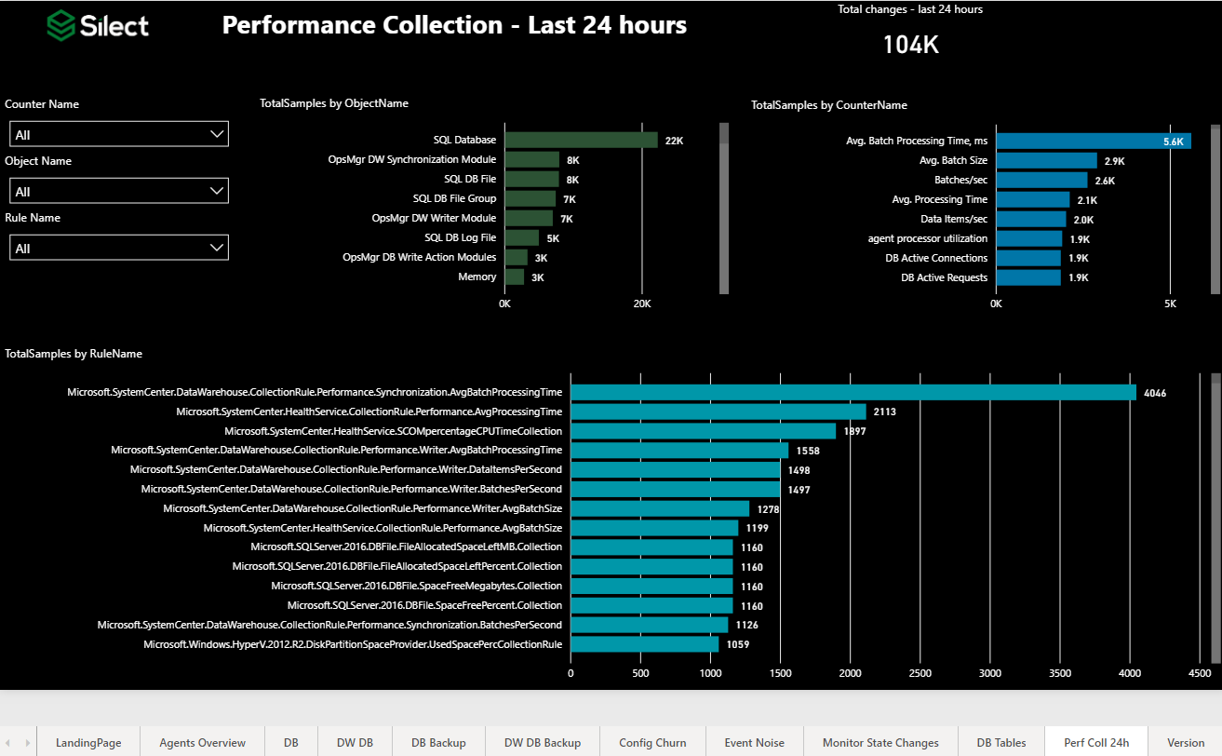
3rd party - Silect
Silect published SCOM Admin dashboards to community (free = public domain)
NOTE: This is tailored to a SCOM Admin to help tune tool of perf/event/alert data

Slide 26
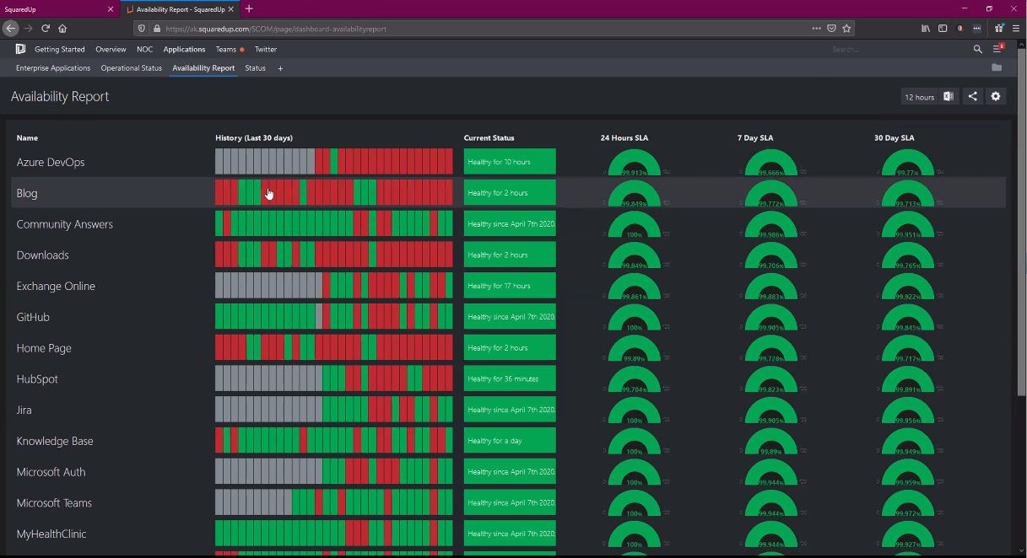
3rd party - SquaredUp
3rd party company around ~10 years
Build out Applications and SLA availability across multiple tools
Mature enterprise by leveraging Application model, network service map, and SLA availability
Build out monitoring of an application discovering components through network traffic

Slide 27
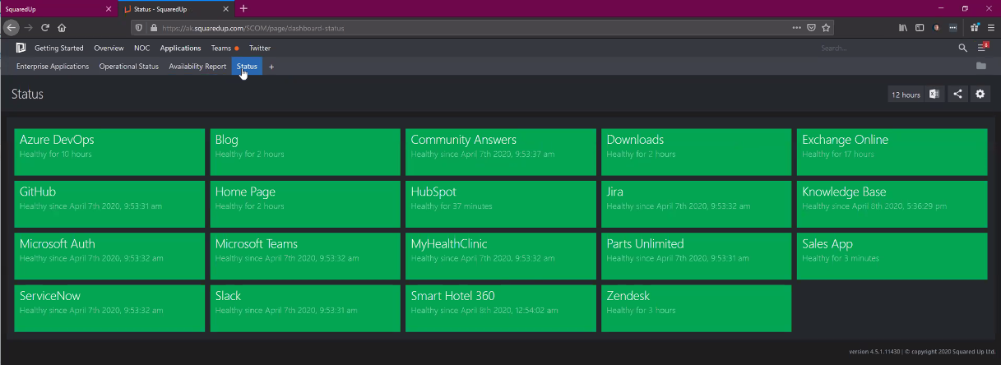
3rd party – SquaredUp - 2
3rd party company
Build out Applications and SLA availability across multiple tools
Mature enterprise by leveraging Application model, network service map, and SLA availability
Build out monitoring of an application discovering components through network traffic

Slide 28
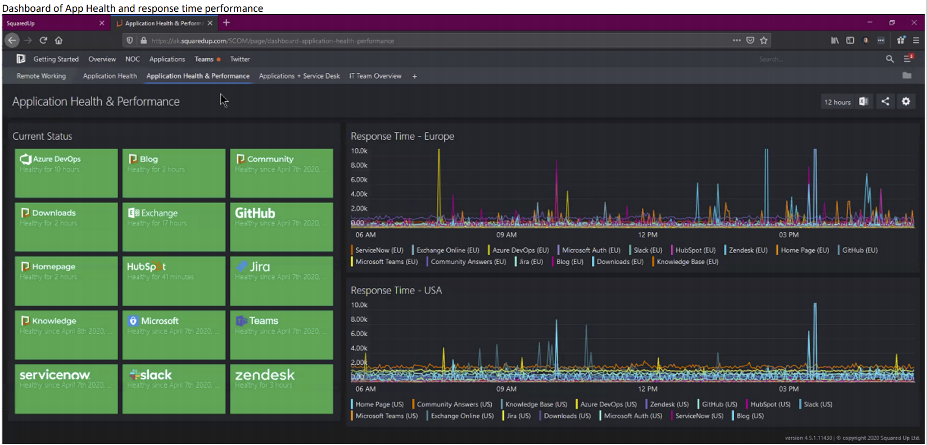
3rd party – SquaredUp - 3
3rd party company
Build out Applications and SLA availability across multiple tools
Mature enterprise by leveraging Application model, network service map, and SLA availability
Build out monitoring of an application discovering components through network traffic

Slide 29
3rd party management packs
Purchase management packs from companies to increase capabilities/functionality

Slide 30
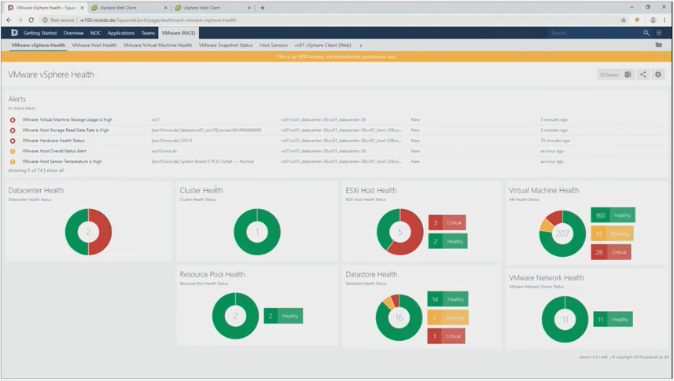
3rd party – NICE - VMWare
3rd party company
Requires purchase of VMWare SCOM management pack for additional monitoring capabilities of virtualization platform/ VMWare health for application teams
Leverages API for connectivity

Slide 31
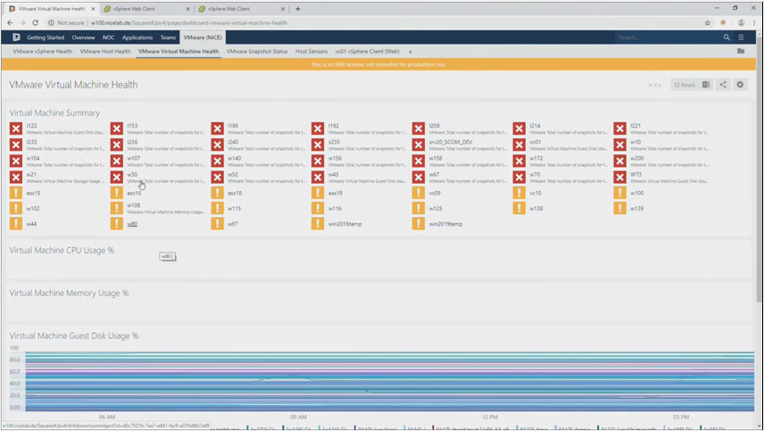
3rd party – NICE – VMWare - 2
VMWare health to see poor performing hosts/virtual machines

Slide 32
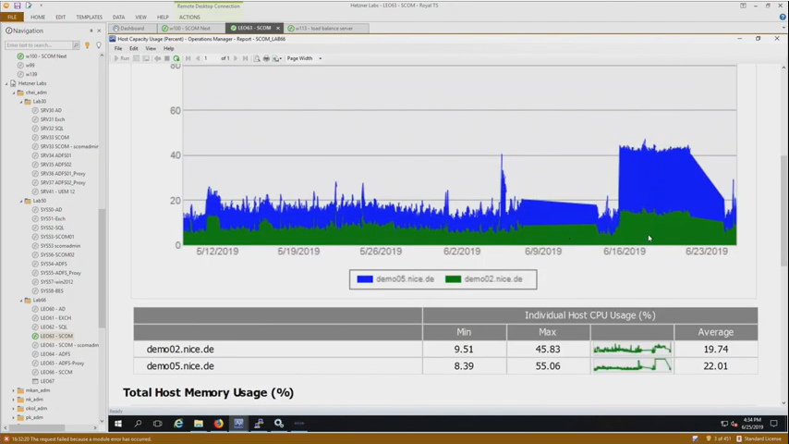
3rd party – NICE – VMWare 3
NICE VMWare management pack –
NON-VMWare Admins can leverage performance graphs, reports, etc.

Slide 33
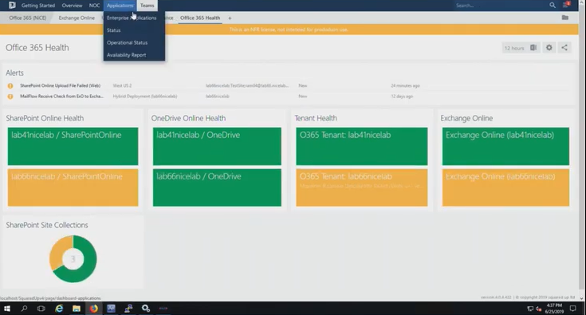
3rd party – NICE – O365
NICE VMWare O365 management pack –
O365 management pack is being assessed for updates by SCOM product group at present

Slide 34
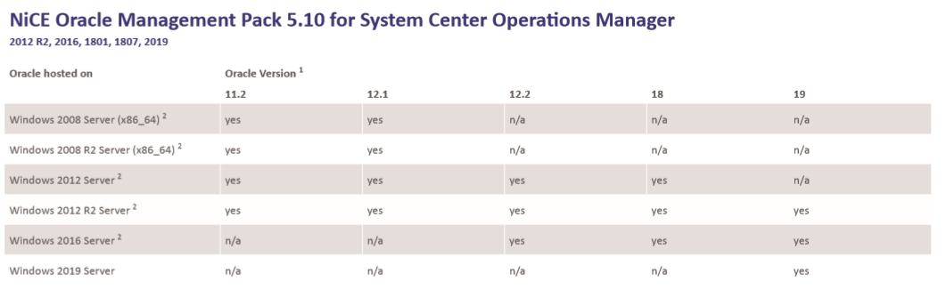
3rd party – NICE - Oracle
NICE Oracle management pack
Provide insights into Oracle databases on Windows

