Slide 1

Operational Dashboards
Leveraging Dashboard tools

Slide 2
Operational Dashboards
SCOM SQL visualizations (metro tile for state/alerts)
PowerBI
3rd party – Silect and SquaredUp

Slide 3
Operational Dashboards - 2
Visualize tool data
  Show degraded and impacting issues is another way to consume
  Notify SME’s of problems
  Notify Teams with reports of issues (summary)
  Unicorn = Single pane of glass
Visualization tools
  SCOM SQL visualizations (metro tile for state/alerts) – little to no cost as part of ELA (Enterprise License Agreement)
  PowerBI – low cost for published reports, uses SSRS for Report gateway
  3rd party tools - Silect and SquaredUp, NICE, Splunk, Solarwinds, VMWare, Tanium, Tychion, HBSS/McAfee

Slide 4
SCOM
SQL Visualizations

Slide 5
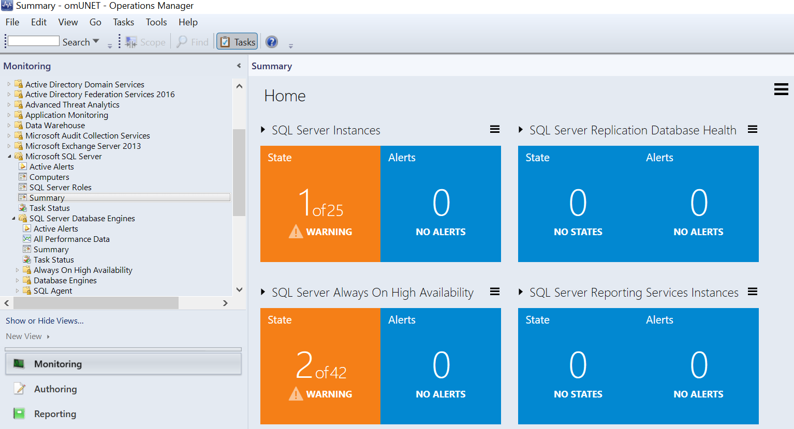
SCOM Visualizations
SCOM SQL
Visualizations
Example - SQL Server Summary View

Slide 6
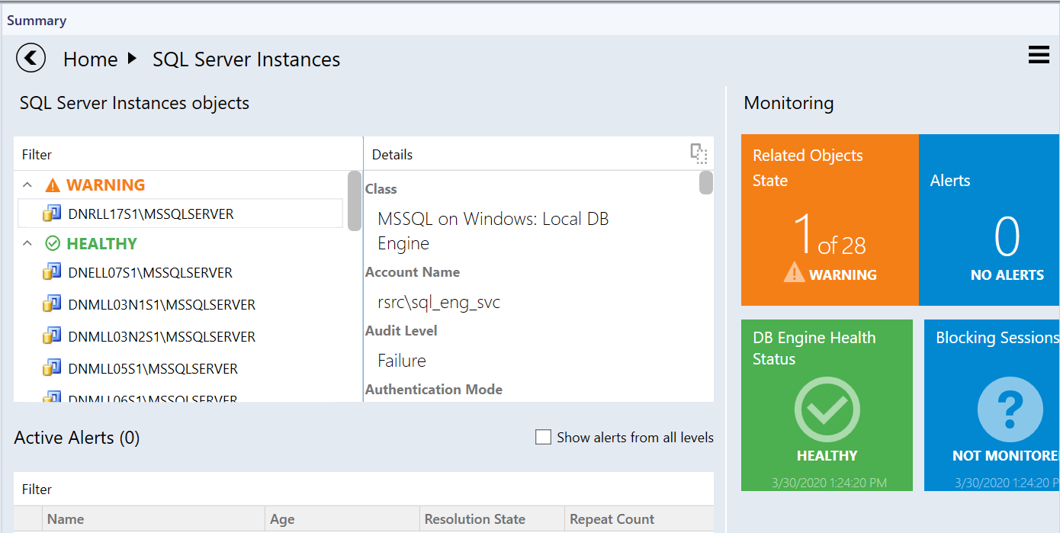
SCOM SQL visualizations
SQL Server Summary View - Drilldown

Slide 7
PowerBI
Leverage SQL DB, XLS and other data sources for visualizations

Slide 8

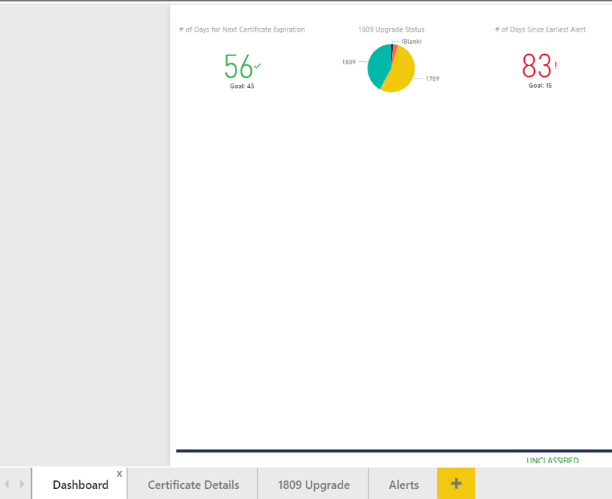
PowerBI
Create high level dashboard with tabs/widgets
To see detailed dashboards (click on tab or double click on graph/icon above)

Slide 9
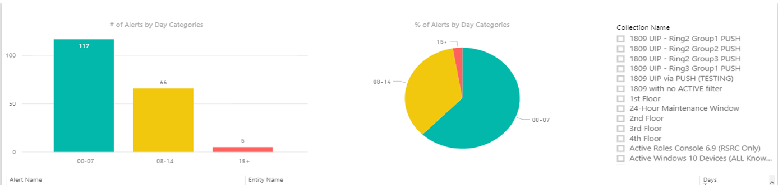
PowerBI - 2
Leverage SQL queries of Tool to visualize
Example pic is MECM data to show collections and alerts by day (age of alerts)

Slide 10
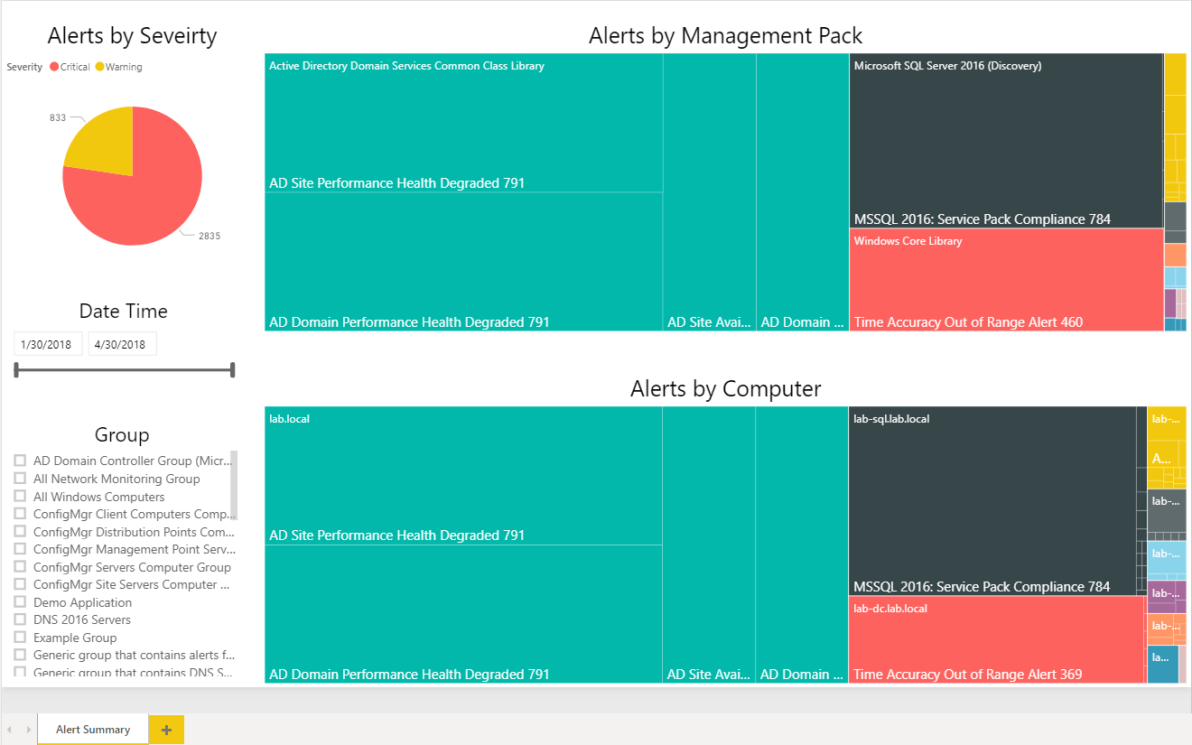
PowerBI - 3
PowerBI has capabilities to ingest any DataSource – i.e. System Center tools, Splunk, Solarwinds, Tanium, etc.
Requires knowledge of DB schema to create visualizations
Example view = Health Map
larger panes are larger amounts of alerts

Slide 11
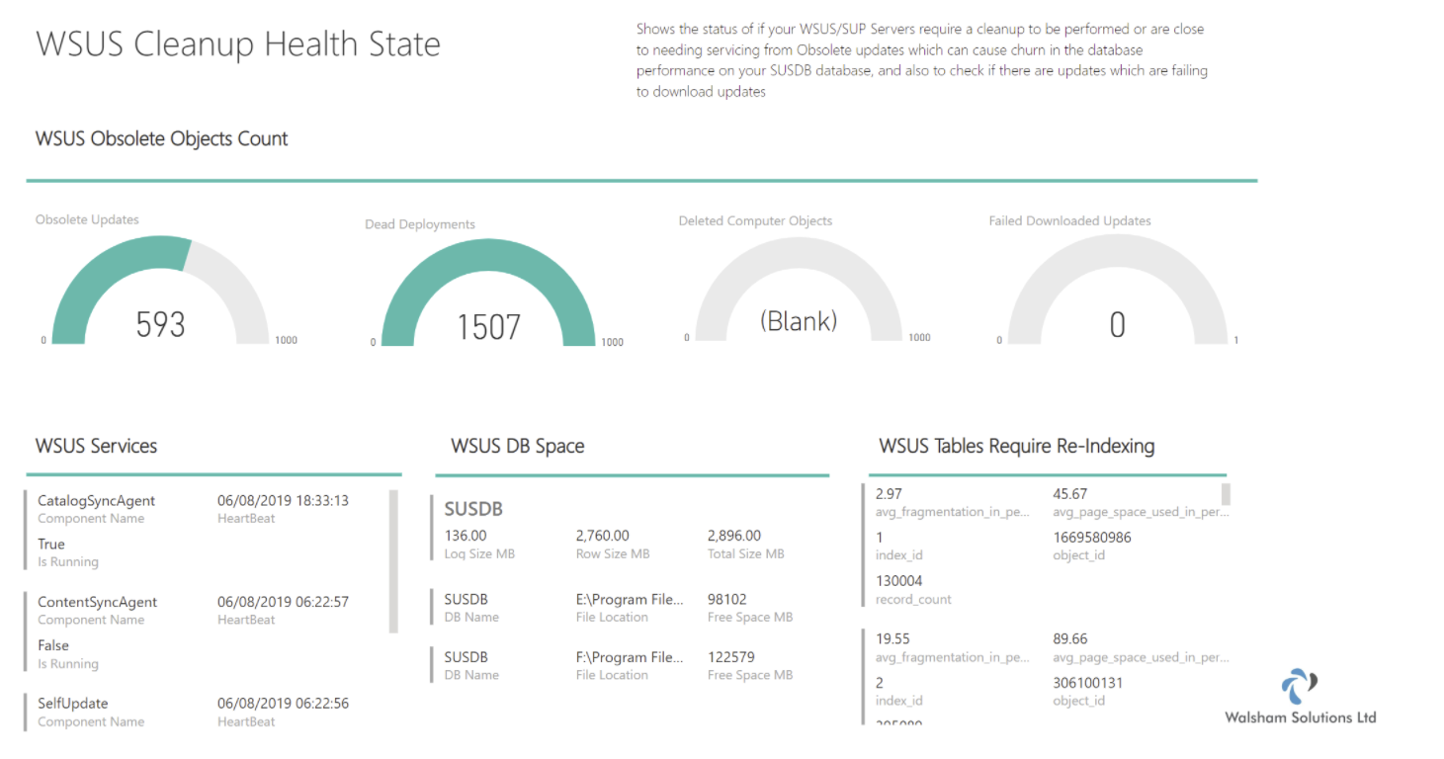
PowerBI - MECM
Leverage published solutions for MECM (formerly SysCtr ConfigMgr)

Slide 12
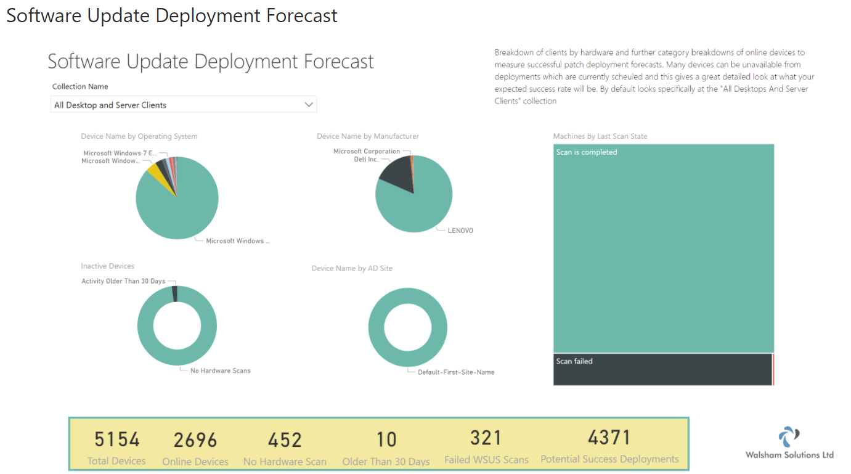
PowerBI – MECM 2
Second example of Software updates

Slide 13
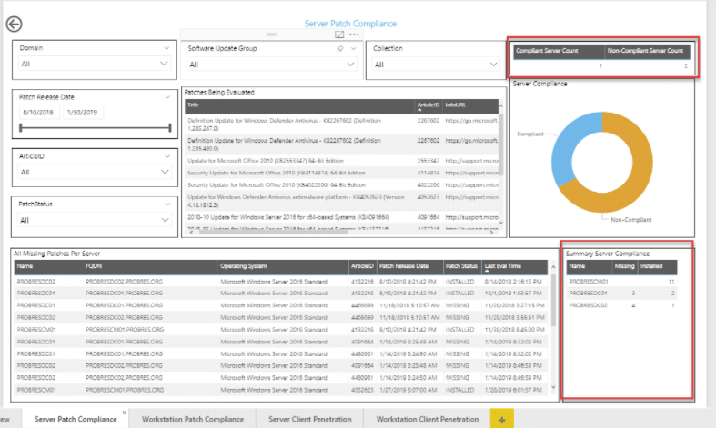
PowerBI – MECM 3
Example of Patch Compliance

Slide 14
3rd party
Visualizations provided by other tools

Slide 15
3rd Party pathway
Pretty much each tool company provides a way to visualize data
  Show degraded and impacting issues is another way to consume
  Notify SME’s of problems
  Notify Teams with reports of issues (summary)
  Unicorn = Single pane of glass
3rd party tools – Silect, SquaredUp, NICE, Splunk, Solarwinds, VMWare, Tanium, Tychion, HBSS/McAfee, VEEAM

Slide 16
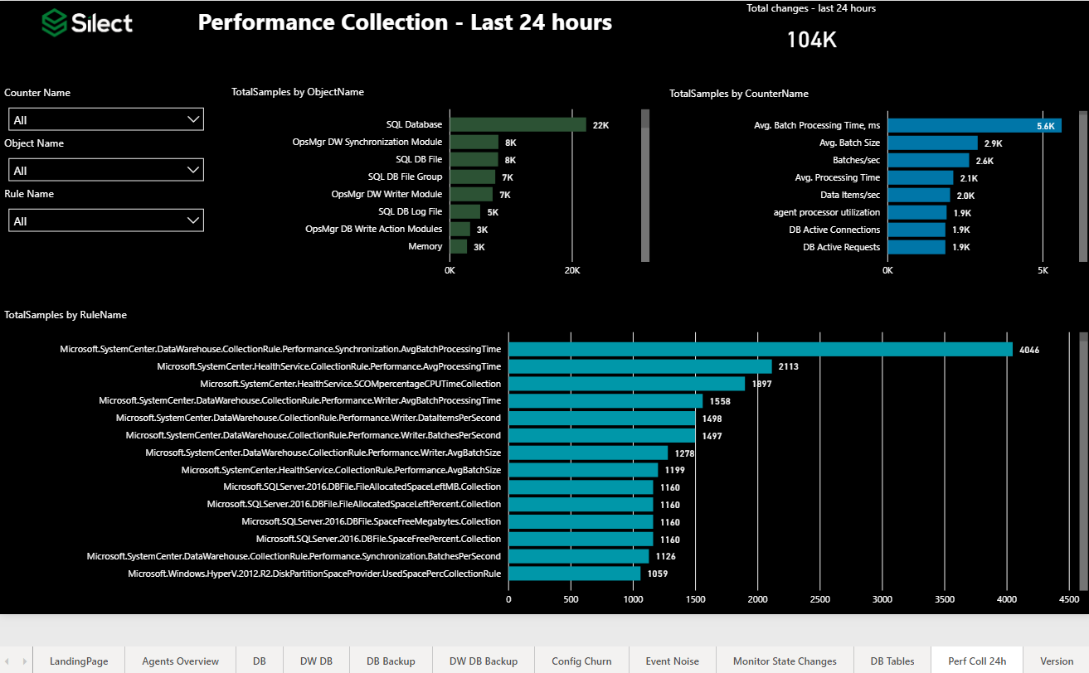
3rd party - Silect
Silect published SCOM Admin dashboards to community (free = public domain)
NOTE: This is tailored to a SCOM Admin to help tune tool of perf/event/alert data

Slide 17
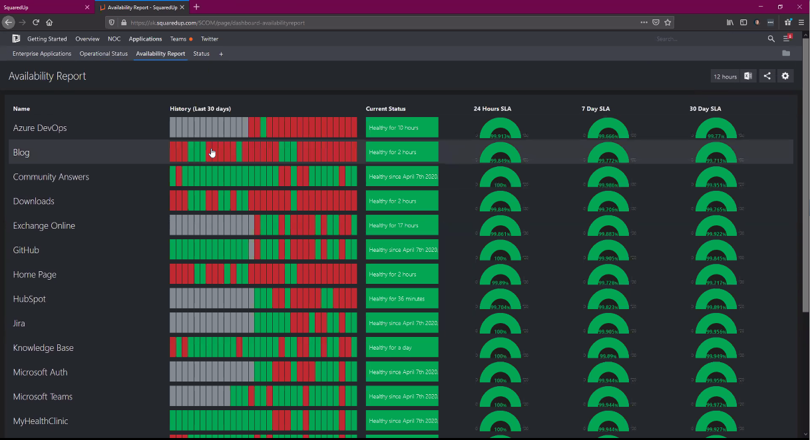
3rd party - SquaredUp
3rd party company around ~10 years
Build out Applications and SLA availability across multiple tools
Mature enterprise by leveraging Application model, network service map, and SLA availability
Build out monitoring of an application discovering components through network traffic

Slide 18
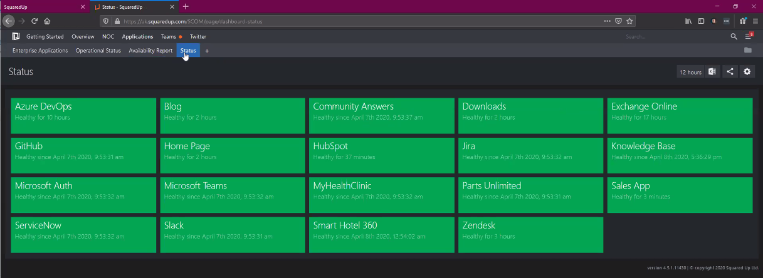
3rd party – SquaredUp - 2
3rd party company
Build out Applications and SLA availability across multiple tools
Mature enterprise by leveraging Application model, network service map, and SLA availability
Build out monitoring of an application discovering components through network traffic

Slide 19
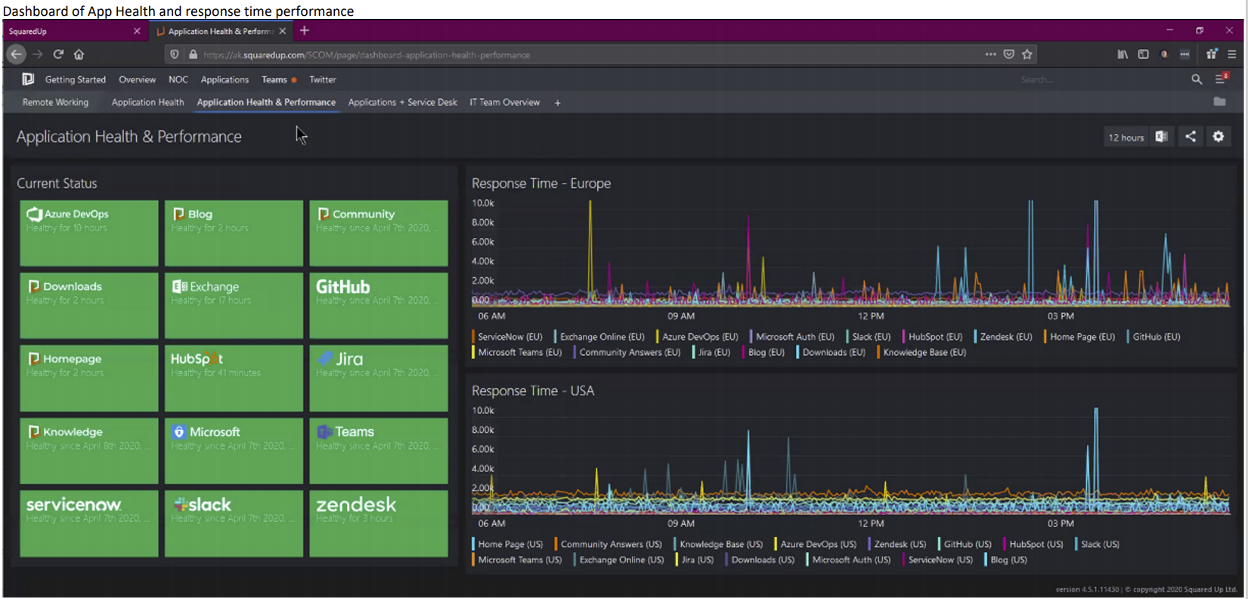
3rd party – SquaredUp - 3
3rd party company
Build out Applications and SLA availability across multiple tools
Mature enterprise by leveraging Application model, network service map, and SLA availability
Build out monitoring of an application discovering components through network traffic

Slide 20
3rd party management packs
Purchase management packs from companies to increase capabilities/functionality

Slide 21
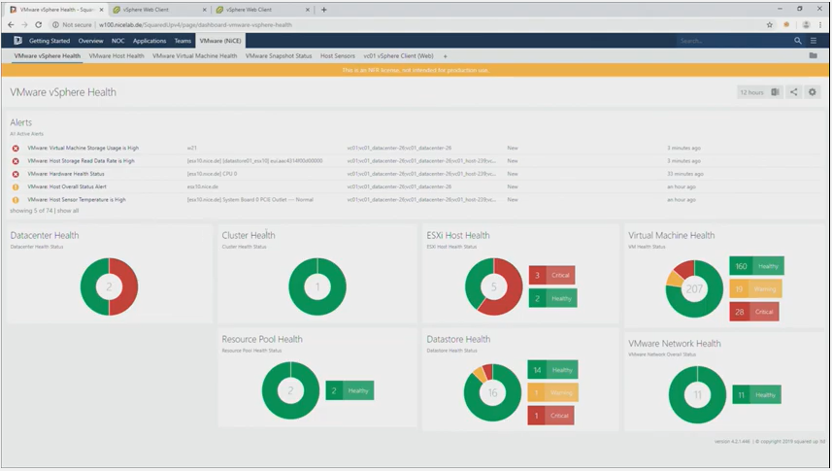
3rd party – NICE - VMWare
3rd party company
Requires purchase of VMWare SCOM management pack for additional monitoring capabilities of virtualization platform/ VMWare health for application teams
Leverages API for connectivity

Slide 22
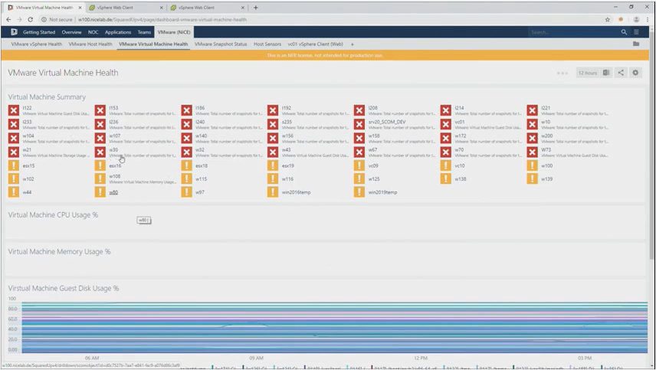
3rd party – NICE – VMWare - 2
VMWare health to see poor performing hosts/virtual machines

Slide 23
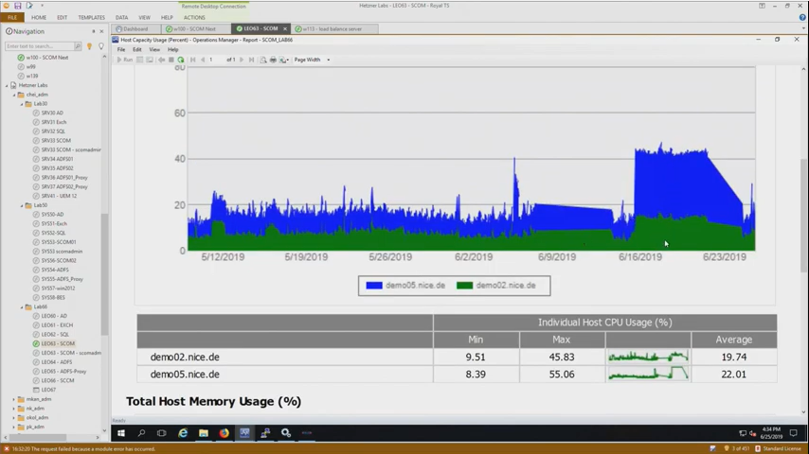
3rd party – NICE – VMWare 3
NICE VMWare management pack –
NON-VMWare Admins can leverage performance graphs, reports, etc.

Slide 24
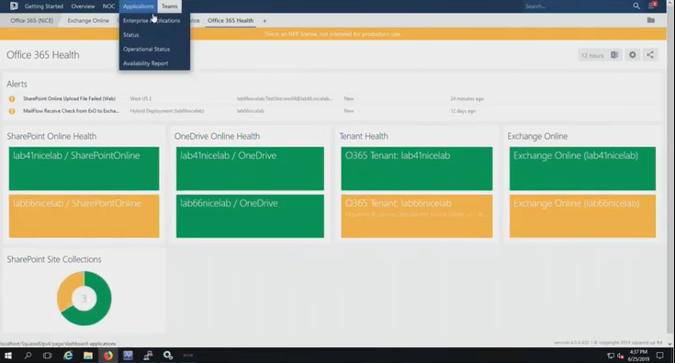
3rd party – NICE – O365
NICE VMWare O365 management pack –
O365 management pack is being assessed for updates by SCOM product group at present

Slide 25
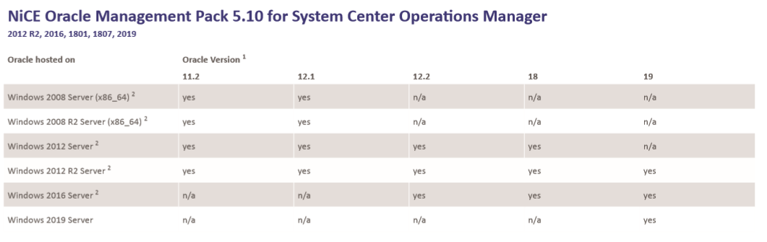
3rd party – NICE - Oracle
NICE Oracle management pack
Provide insights into Oracle databases on Windows

